Slide 1


Stocks with the highest Gain: 1996 to 2020
By: Mason Barrios
Joaquin Flores
Jasmine Gomez
Dylan Mora

Slide 2

Introduction
Stock Data from 1996 to 2020
Dataset (12GB) from Kaggle.com provided by Dip Modi
104,123 individual stock tickers
Pig utilized to analyze data
HDFS used for storage
Link to Dataset (2GB Compressed, 12GB Unzipped): https://www.kaggle.com/aceofit/stockmarketdatafrom1996to2020

Slide 3
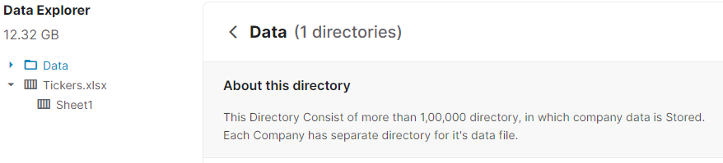
Introduction
Dataset (12GB) from Kaggle.com provided by Dip Modi
104,123 individual stock tickers

Slide 4

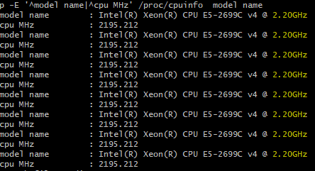
specifications
Cluster Version: Hadoop 2.7.1.2.4.2.0-258
Number of Nodes: 4
Memory: 124GB
CPU: Intel(R) Xeon(R) E5-2699C v4
CPU Speed: 2.20GHz

Slide 5
retrieving the data
WGET is used to download the data locally.
Due to insufficient space, dataset is downloaded to temporary file systems (tmpfs /dev/shm).

Slide 6

Moving the data
From the Linux machine, we move the data to HDFS via the –put command
This function takes 1 hour and 10 minutes to complete

Slide 7
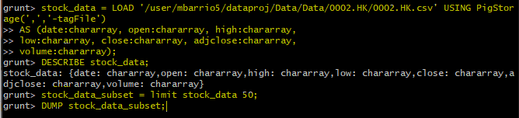
Using apache Pig
In pig we create a sample script and test it against one stock ticker
After we determine the schema, we modify the script to include all 104,123 stock tickers

Slide 8
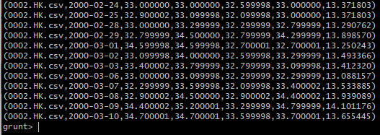
Example of test output

Slide 9
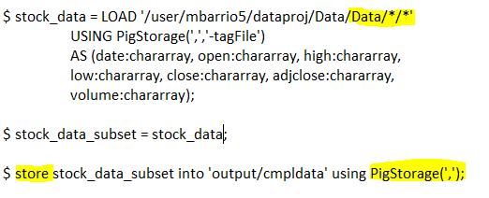
Finalizing pig script
Script is revised after testing and all 104,123 tickers are stored into a single file (~13GB, process takes ~27 minutes)

Slide 10
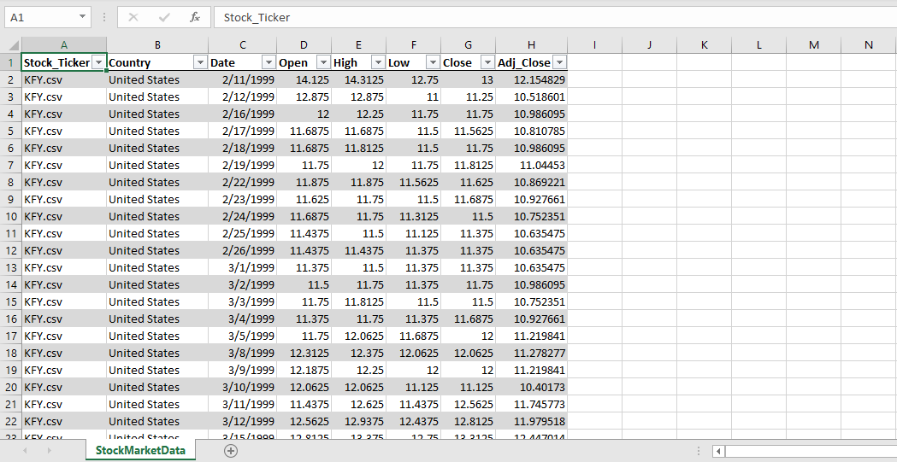
Data in excel

Slide 11
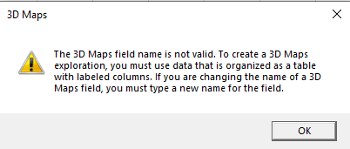
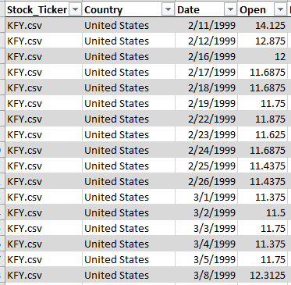
Issues with the project
Time Series (Excel Error)
Excel did not accept "DATE" column
We were unable to include a TIME dimension to the data visualization
Some countries insufficient data, ex: Brazil

Slide 12
The findings: Greatest gains by country
United States: Δ 6,194 GPTX (Global Payments Technologies)
Canada: Δ 6,113 PSH.V (Petrolshale Inc.)
France: Δ 60,080 LTA.PA (Altamir SCA)
United Kingdom: Δ 6,278 JAM.L (JP Morgan)
NOTE: excluded other countries due to lack of data

Slide 13


GPTX (US) and PSH (Can)

Slide 14


Lta.pa (fra) and jam.l (UK)

Slide 15

Conclusion
Out of the four countries sampled, financial institutions (or finance related) stock tickers saw the highest gains over the course of 24 years.

Slide 16
Related works
Long short-term memory model (LSTM) : LSTM is a technique subtle for processing and predicting important events. LSTM is an extended variant of RNN, a deep learning model that is good at processing time-series data.
Empirical Mode Decomposition (EMD) : EMD is a signal analysis method; it can decompose a complex signal into a finite intrinsic mode function (IMF)

